Slide 1
THE TEAM
Multi Cloud Subscription & Cost Management Application
Software Product Management
Group AH – Assignment 1
1. MALLIDI AKHIL REDDY (2024TM93056)
2. CHITTAJALLU PREM GURUMUKH (2024TM93279)
3. MANAN PRAVINKUMAR PARMAR (2024TM93030)
4. PRAKASHA G (2024TM93260)
5. UDYAGIRI VENKATAGURU PRASAD (2022TM93653)

Slide 2
Problem Statement
Overview: Organizations are increasingly adopting cloud services, with global cloud spending expected to reach $832 billion by 2025. However, nearly 40% of this spend is wasted due to inefficiencies and poor management.
Over-Provisioning of Resources: Up to 60% of cloud resources are over-provisioned, leading to inflated costs. Companies can reduce expenses by 25-30% through effective management, but many lack the necessary tools.
Lack of Visibility into Cloud Usage: 93% of organizations struggle with visibility into cloud usage, and 82% report difficulties in understanding cost allocation, resulting in unoptimized environments and wasted spend.
Difficulty Managing Multiple Cloud Subscriptions: 81% of enterprises operate in multi-cloud environments, with 70% facing challenges in managing subscriptions, consolidating billing, and maintaining governance.
Unpredictable Cloud Costs: Unpredictable costs are a top concern for 80% of cloud users. 55% of organizations exceed their cloud budgets by an average of 23%, affecting financial planning and ROI.

Slide 3
Customer Segment - Where it Will Be Used The primary customer segments for the proposed AI-powered cloud cost management app include:
Medium to Large Enterprises: These organizations use multiple cloud platforms like AWS, Azure, and Google Cloud and often struggle with managing costs across these platforms.
Example: Netflix relies heavily on cloud services to stream content globally. Managing the cost across multiple regions and services is complex, and an AI-powered solution can help optimize these costs dynamically.
IT Departments and Cloud Operations Teams: Individuals responsible for managing cloud resources and budgeting within organizations will benefit directly from using this app.
Example: Adobe has multiple cloud-based services such as Creative Cloud and Document Cloud. Their IT teams need tools that can provide visibility into usage and optimize resource allocation.
Cloud Service Resellers and Managed Service Providers (MSPs): These companies manage cloud services on behalf of their clients and require tools to optimize costs and provide value-added services.
Example: Rackspace Technology is a managed cloud computing company that helps businesses manage their cloud infrastructure across various platforms. Cost management tools are critical for them to optimize costs for their clients.

Slide 4
Pain Points The key pain points addressed by the AI-powered cloud cost management app include:
Over-Provisioning of Resources: Organizations often allocate more cloud resources than necessary, leading to increased costs.
Lack of Visibility into Cloud Usage: Without a centralized view, organizations struggle to monitor and manage cloud usage effectively.
Difficulty in Managing Multiple Cloud Subscriptions: Managing subscriptions across different cloud platforms can be complex and time-consuming.
Unpredictable Cloud Costs: Fluctuations in usage and varying pricing models can make it challenging to predict and control cloud expenses.

Slide 5
Product Idea The proposed product is an AI-powered cloud cost management app designed to automate resource management, optimize costs, and provide centralized control over multi-cloud subscriptions.
Automatic Resource Management: Uses AI to dynamically allocate and deallocate resources based on real-time usage and historical data.
Centralized Multi-Cloud Subscription Management: Provides a unified interface for managing subscriptions across multiple cloud platforms.
Real-Time Cost Monitoring and Alerts: Uses AI to detect anomalies and send alerts for unusual spending patterns.
AI-Driven Cost Optimization Recommendations: Offers suggestions to optimize cloud spending by identifying unused resources and recommending cheaper alternatives.
Budgeting and Forecasting Tools: Utilizes AI to forecast future cloud costs based on past trends and usage patterns.

Slide 6
Target Market The target market for the AI-powered cloud cost management app includes:
Large Enterprises and Corporations: These organizations have complex cloud environments with multiple subscriptions and significant cloud spending.
Example: General Electric (GE) has multiple divisions using cloud services for different applications, making cost management a complex task. AI-driven insights could streamline this process.
Small to Medium Enterprises (SMEs): SMEs with growing cloud needs and a focus on cost control will also find value in the app.
Example: Slack started as an SME and used multiple cloud services for its operations. Efficient cost management was crucial for maintaining profitability during its growth phase.
Cloud Service Resellers and MSPs: Companies offering cloud services to other businesses and looking to optimize cloud costs for their clients.
Example: Accenture offers cloud management services to various clients and could benefit from tools that provide cost transparency and optimization capabilities.

Slide 7
Product Opportunity
Value proposition
Cost Efficiency: Identify underused resources and suggest more cost-effective pricing solutions to optimize cloud spending.
Centralized Management: Monitors and manages cloud subscriptions and costs across multiple cloud providers in one centralized dashboard.
AI powered cost Optimization Recommendations: AI powered historical data and forecasts future costs to inform resource allocation decisions.
Improved Efficiency: It automates routine tasks, such as tracking costs, managing budgets, and renewing subscriptions.

Slide 8
Assess the opportunity
Customer Feedbacks
IT Head (Chinmoy): “We've been struggling to manage our organization's cloud usage across different service providers. Approximately 65% of our resources are managed manually, increasing the risk of errors and inefficiencies. Integrating APIs with existing systems could save us up to 30% in time and reduce operational overhead by 20%.”
Start-up / Small-Case Enterprise (Where is My Train Head): “Our goals of optimizing cloud expenditures and improving financial oversight are well aligned with the proposed app. We have seen over 25% of our cloud budget wasted due to overspending and underutilization. Implementing a feature to prevent over-spending could help us save around $50,000 annually.”
Medium Enterprise (Thomson-Reuters): “The product has the potential to simplify our IT admin tasks. With over 10,000 cloud instances and subscriptions managed across our departments, we estimate that robust reporting capabilities could reduce manual reporting time by 40%, translating to operational cost savings of approximately $200,000 per year.”
Big Enterprise (DP World): “Efficient cloud cost management and streamlined subscription handling are critical for us. With data security being our top priority, any breach could cost us millions in regulatory fines and lost business. Ensuring secure data handling and robust compliance measures could protect our $500 million annual revenue from potential threats.”
Resellers: “As resellers, the ability to offer AI-powered cost management solutions is crucial. We handle over 1,000 cloud accounts for our clients, and the integration of AI could enhance our service quality by 35%, leading to an estimated 20% increase in client satisfaction and retention.”

Slide 9
ASSESS THE OPPORTUNITY
Under-Served needs – Re-assess based on Customer Interviews
Data Security and Compliance: Security of the data shared or transferred should be high priority.
Budgeting: Options to inform/anticipate the cost forecast to users
Integration with Existing Systems: Integration with IT ticket tools or to other existing environments
Customization : Customization options may be limited and may not meet big enterprises.
Pain-Points Re-assess based on Customer Interviews
Privacy Concerns: Organisations will be concerned on the data being accessed is shared outside.
Logging: Tracking of actions performed by the user and role-based access to the application.
Cost compare: Cost compare with different cloud providers.
Report : Option to collect detailed reporting of underutilization, cost matrix.
AI powered solutions: Clients look at AI powered solutions and opportunities.

Slide 10
Final product
The software allows users to manage and view resources and costs associated with multiple cloud service providers.
Software provides timely alarms to users to regarding budget and optimization opportunities.
Role-based access to application
User friendly dashboard
AI powered data driven decisions/suggestions.
Detailed reporting.

Slide 11
Final Value proposition
Cost Efficiency: Avoid over-provisioning and overspending by optimizing resource allocation. Gain visibility into actual cloud usage, enabling more accurate budgeting and reducing unnecessary expenditures.
Enhanced Visibility and Control: Implement tools and processes to provide a clear, real-time overview of cloud usage across all services and providers. This empowers organizations to make informed decisions and manage resources proactively.
Simplified Cloud Operations: Streamline the management of multiple cloud subscriptions by consolidating governance and adopting a unified strategy. Reduce complexity and improve operational efficiency across diverse cloud environments.
Improved Resource Utilization: Identify and eliminate idle or underutilized resources, ensuring that every dollar spent on cloud services contributes to meaningful business outcomes.
Agility and Scalability: Allow organizations to dynamically scale cloud usage based on demand, maintaining optimal performance while controlling costs.
Better Financial Forecasting and Planning: Achieve predictable cloud costs through effective monitoring, management, and optimization practices, enhancing overall financial stability and planning.

Slide 12
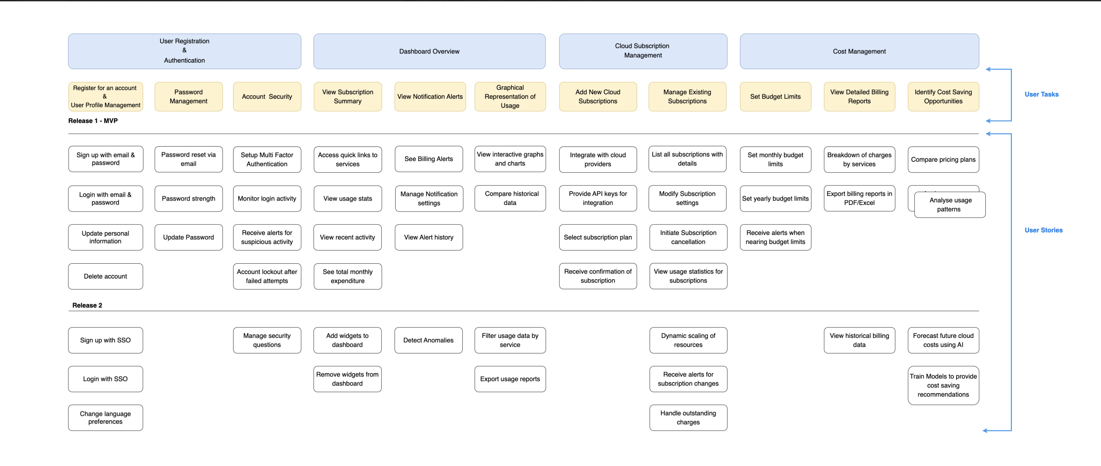
Story Map

Slide 13
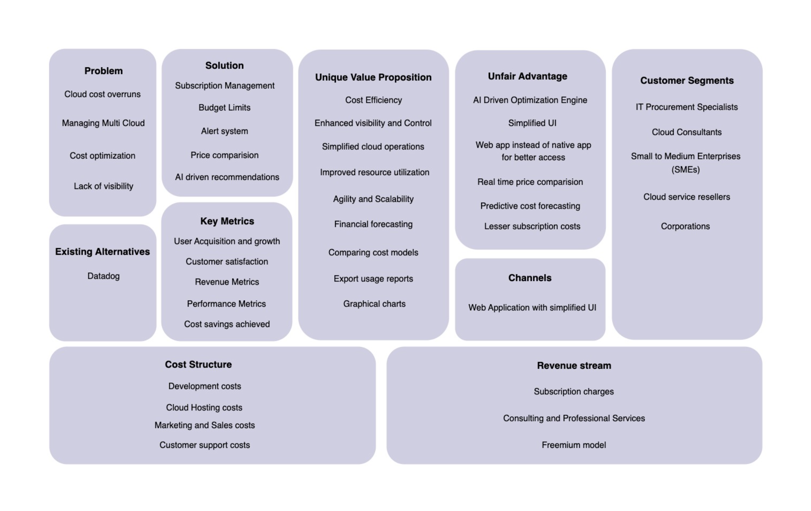
Lean Canvas Start-up

Slide 14
Work Products
Cloud Usage Analysis and Cost Optimization
Reports: Reports providing insights on cloud usage patterns and actionable strategies for cost reduction.
Multi-Cloud Management Framework: A structured approach to managing resources and costs across multiple cloud providers, centralizing governance and cost control efforts.
Dashboard for Real-Time Cloud Cost Monitoring: A dynamic tool providing real-time visibility into cloud expenditures, usage metrics, and performance, with alerts for unexpected spending.
Cloud Cost Management Play book: A practical guide with step-by-step processes, checklists, and templates for teams to effectively manage and reduce cloud costs.
Cloud Cost Allocation Models: Detailed methodologies for distributing cloud costs across departments, projects, or business units to ensure accountability and transparency.
Cost Management Tool Implementation Plan: A strategic roadmap for selecting, deploying, and integrating cloud cost management tools within the organization, ensuring smooth adoption and effectiveness.
Cloud Cost Benchmarking Studies: Comparative analyses to measure the organization’s cloud costs against industry standards or peers, identifying potential areas for cost optimization.
Automated Cloud Cost Alerts and Notifications System: An automated system for setting up alerts and notifications based on usage thresholds, budget limits, or unexpected spikes in spending.

Slide 15
Outcomes
Optimized Cloud Spending: Achieve significant cost savings by effectively allocating resources, reducing waste, and right-sizing cloud services.
Enhanced Cost Visibility: Gain complete transparency into cloud expenditures, empowering stakeholders to monitor, manage, and control costs effectively.
Boosted Operational Efficiency: Streamline cloud operations to minimize complexity, maximize productivity, and ensure efficient use of resources.
Accurate Financial Planning: Improve budgeting and forecasting capabilities for cloud expenses, leading to stronger financial management and stability.
Maximized Resource Utilization: Ensure every cloud asset is fully utilized, eliminating idle or underused resources, and maximizing value for every dollar spent.
Strengthened Governance: Implement robust governance frameworks for managing cloud resources and costs, ensuring compliance and effective control across all providers.
Increased Agility and Scalability: Rapidly scale cloud resources up or down based on demand, maintaining performance while optimizing costs.
Unified Stakeholder Alignment: Foster a shared understanding and cohesive approach to cloud cost management among finance, engineering, and operations teams.
Higher ROI and Competitive Edge: Drive greater return on cloud investments by aligning costs with business objectives, fostering innovation, and maintaining a competitive market position.

Slide 16
Key Learnings – Mallidi Akhil Reddy (2024TM93056)
Learned how to clearly define a business plan along with determining the business's problems, identifying its target market, and creating a unique value proposition that makes it sustainable and different.
Gathering customer feedbacks helped me understand their needs and helped me to identify pain points and areas for improvement in our product and services.
The story map exercise helped to clarify the different features and components of the product and how they fit together to solve customer pain points.
Importance of the Startup Canvas which help in summarizing the entire Business plan and its key features and can also help in getting the funding from the investor’s.

Slide 17
Key Learnings – Chittajallu Premgurumukh (2024tm93279)
Importance of identifying customer pain points and needs and using them to drive product development.
The value of customer feedback and reviews. With the help of customer feedback and adapting the product to better meet their needs, we can create a product that truly solves their problems and provides value.
Understanding the need for managing resources with multiple cloud service providers and costs associated with them.
Great opportunity of working with the team and great collaboration among all.

Slide 18
Key Learning- Prakasha G (2024TM93260)
Importance of identifying customer pain points and needs and using them to drive product development.
The value of customer feedback and reviews. With help of customer feedback and adapting the product to better meet their needs, we can create a product that truly solves their problems and provides value.
Understanding need of managing resources with multiple cloud service providers and costs associated with them.
Great opportunity of working with team and great collaboration among all.

Slide 19
Key Learnings – Manan Parmar(2024TM93030)
Customer-Centric Approach
I realized the importance of segmenting the customer base (Enterprises, IT departments, MSPs) to design features that cater to their specific needs. Analyzing real-world examples like Netflix and Adobe helped me understand the complexities these companies face in managing cloud costs.
Harnessing the Power of AI
Integrating AI for real-time cost monitoring, anomaly detection, and resource management was a game-changer. Additionally, using predictive analytics for budgeting and forecasting taught me how valuable historical data can be in anticipating future costs.
Addressing Core Pain Points
I focused on solving key issues such as over-provisioning and unpredictable cloud costs. Developing tools for cost optimization and centralized control across multiple cloud platforms was crucial in providing value to users.
Strategic Market Focus
Understanding that the product needed to be scalable was essential, especially to cater to both large enterprises and SMEs. Learning from companies like GE and Slack, I ensured the product could adapt and grow with customer needs.

Slide 20
Key learnings – Udyagiri VenkatagurU Prasad (2022MT93653)
Learned how to clearly define a business plan along with determining the business's problems, identifying its target market, and creating a unique value proposition that makes it sustainable and different.
Gathering customer feedback helped me understand their needs and helped me to identify pain points and areas for improvement in our product and services.
The story map exercise helped to clarify the different features and components of the product and how they fit together to solve customer pain points.
Importance of the Startup Canvas which helps in summarizing the entire Business plan and its key features and can also help in getting funding from investors.

Slide 21
Thank you

